Slide 1

Wall Tetris Project
Supervisor: Boaz Mizrachi
Presented by: Mohammad Sarris, Yanal Gawanma winter 2024

Slide 2
Project Motivation
learning about embedded systems.
Combining Software and Hardware Skills.
Learning Advanced Communication Protocols.
Addressing Technical Challenges.

Slide 3
Project Goals
Develop a Functional Tetris Game.
Integrate Android App with ESP32.
Design and Assemble a 20x40 LED Matrix.
Ensure Real-time Communication.
Implement Score Tracking and Display.
Overcome Technical Challenges.

Slide 4
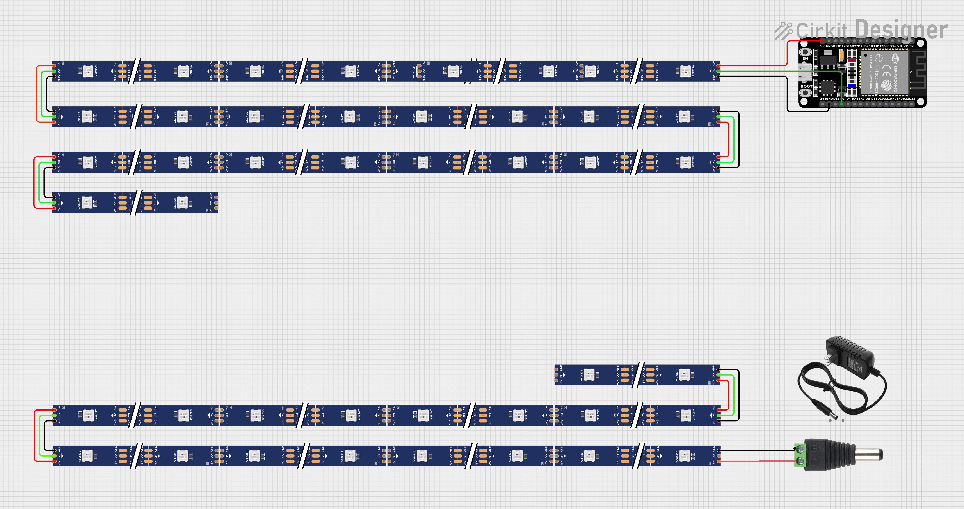
Final Physical layout
20 LED’s Per Row
Connected the LED strips like a zigzag shape as a one long strip
40 Rows
40 * 20 = 800 LEDs
Data flow

Slide 5
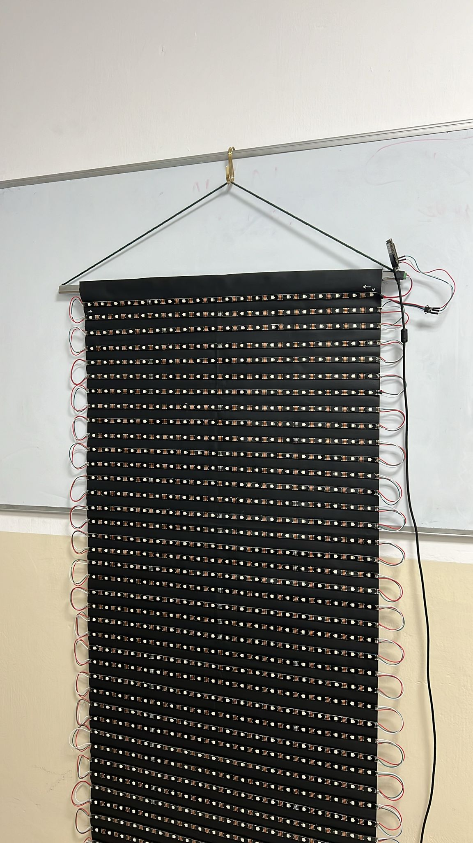
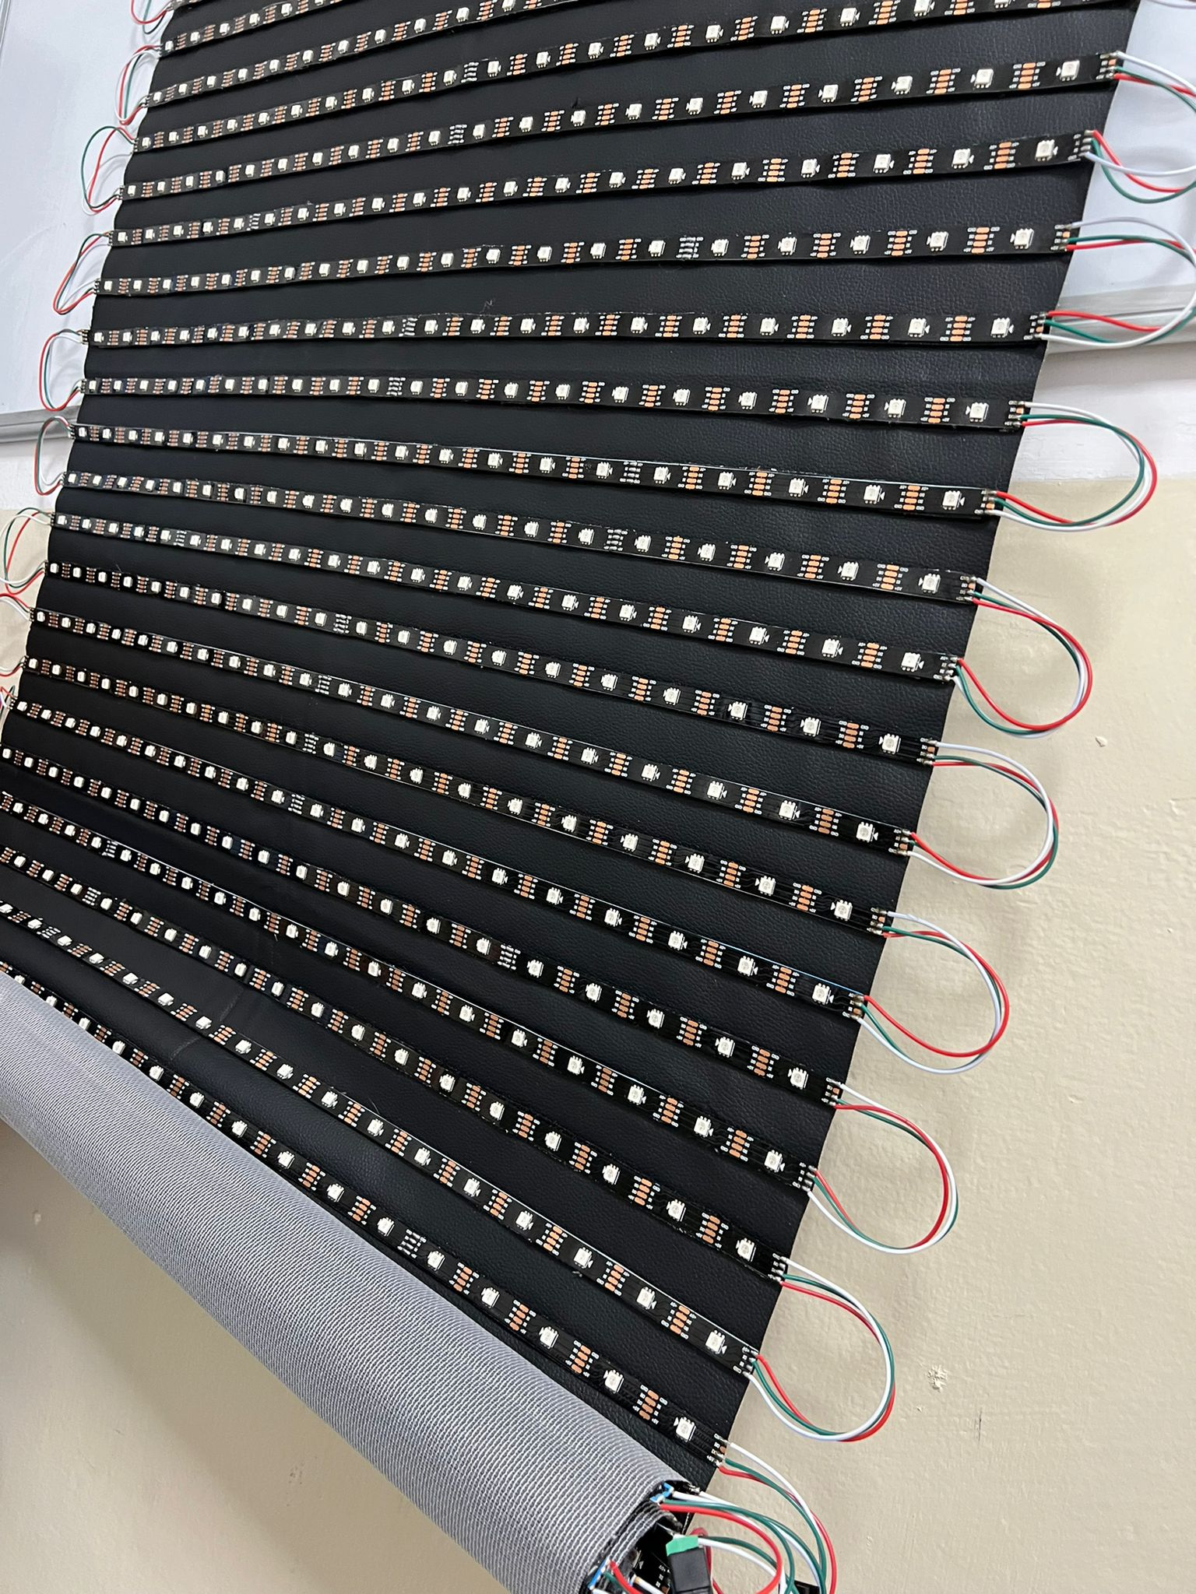
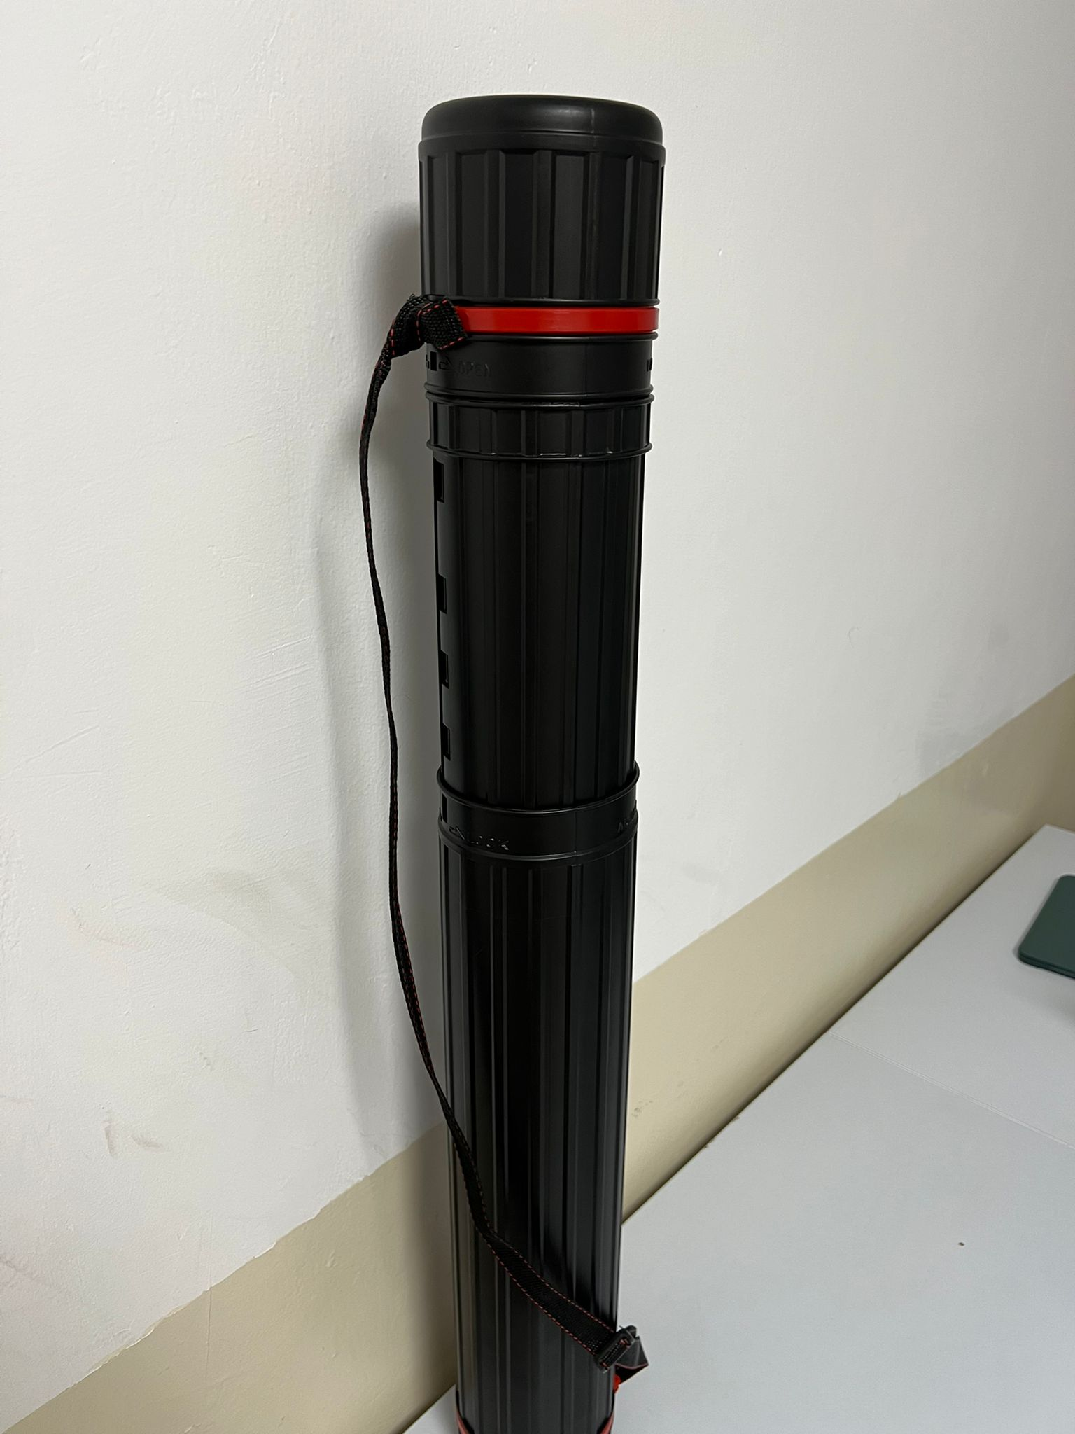
Mechanical Layout
Hangable
Foldable
Portable

Slide 6
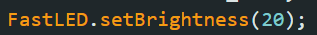
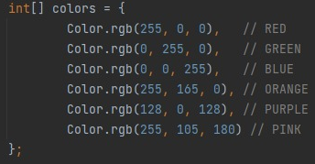
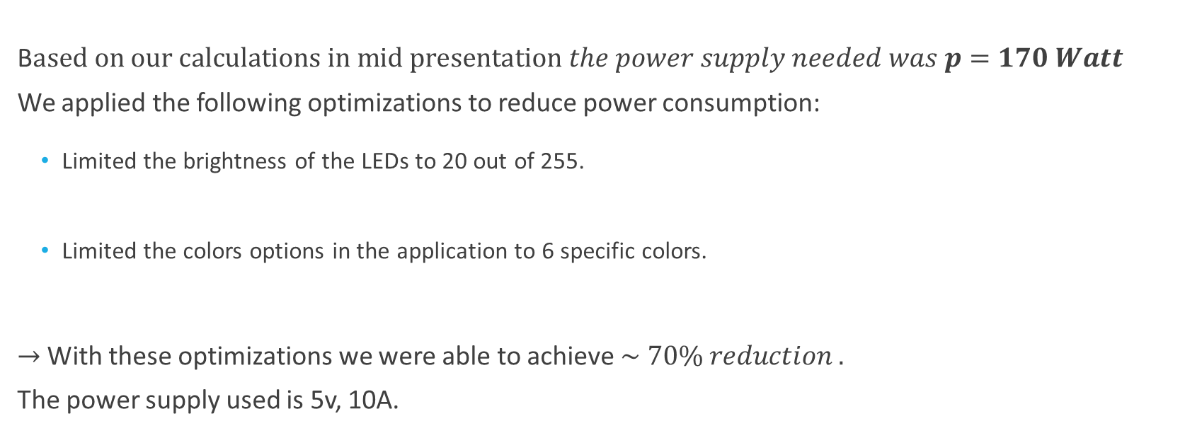
Power Consumption and Optimization
B$ased on our calculations in mid presentation the power supply needed was p=170 Watt$
We applied the following optimizations to reduce power consumption:
Limited the brightness of the LEDs to 20 out of 255.
Limited the colors options in the application to 6 specific colors.
$→$With these optimizations we were able to achieve $\sim 70\% reduction .$
The power supply used is 5v, 10A.

Slide 7
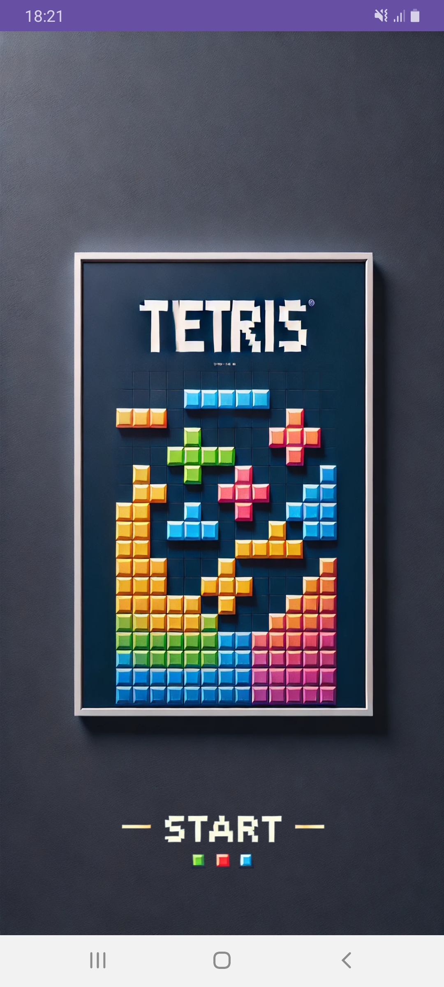
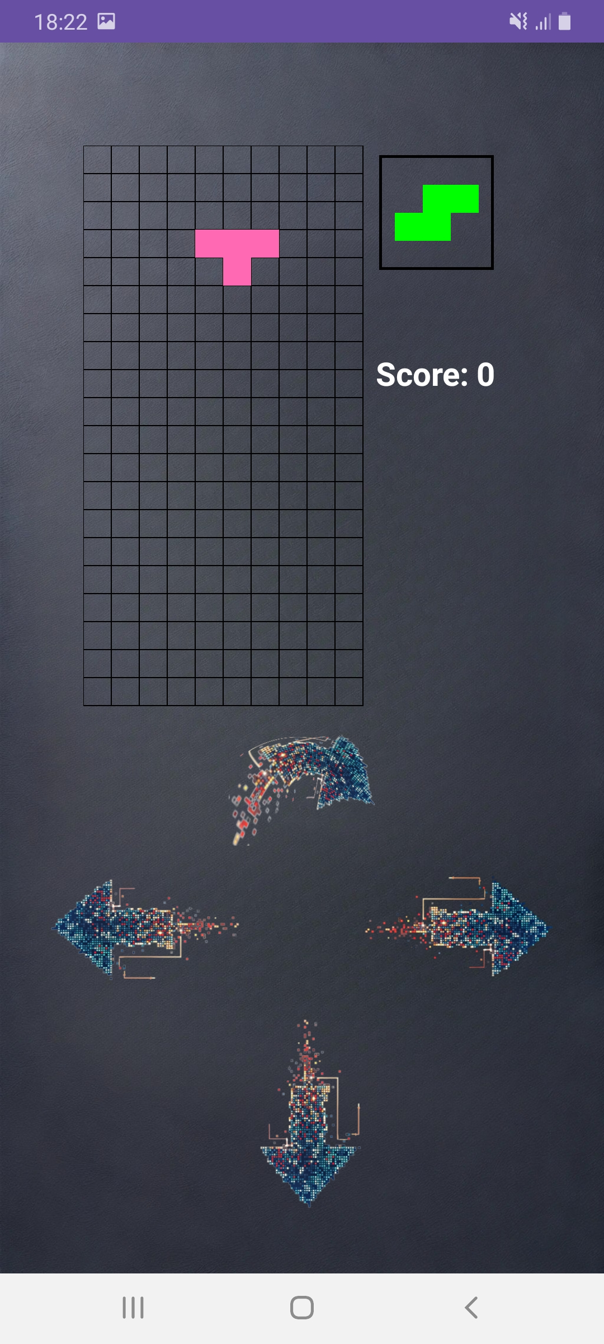
Tetris Application
Developed Tetris game application in Android Studio.
Application features:
Opening frame.
Left, Right, Rotate and Drop buttons.
Next block review box.
Score display.
Web socket connection with the esp32.

Slide 8
Application Classes
MainActivity:
Runs game activity and handle web socket connection and data transfer.
OpeningActivity:
Runs and handle game opening frame.
GameBoardView:
Runs all game functionality including game board display, updating score, block and cells functionality.
GameBoardState:
Holds a list of Blocks on board.

Slide 9
Application Classes
BlockFactory:
Creates different types of blocks and assign random color to them.
Block:
Represents a Tetris block and holds a list of cells.
Cell:
Handles the behavior of the cells of each block.

Slide 10
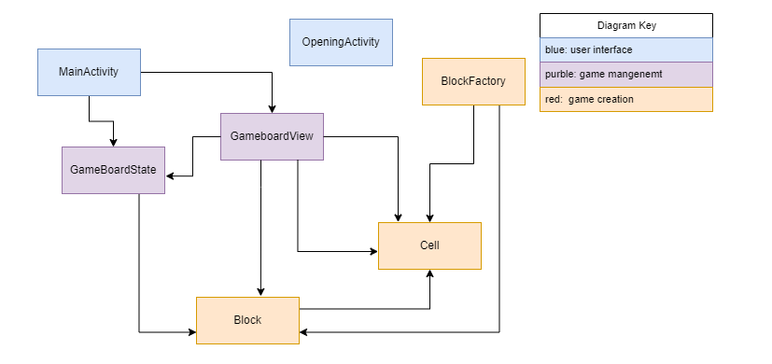
Class Diagram

Slide 11
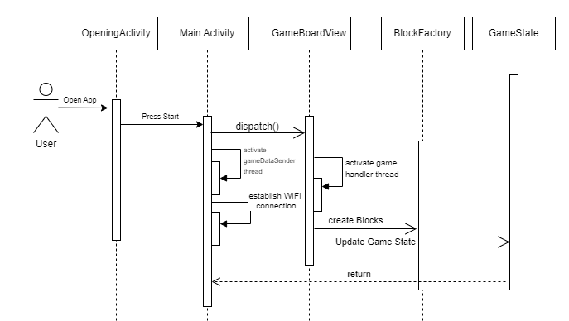
Start game sequence diagram

Slide 12
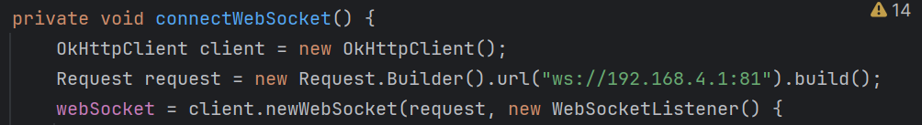
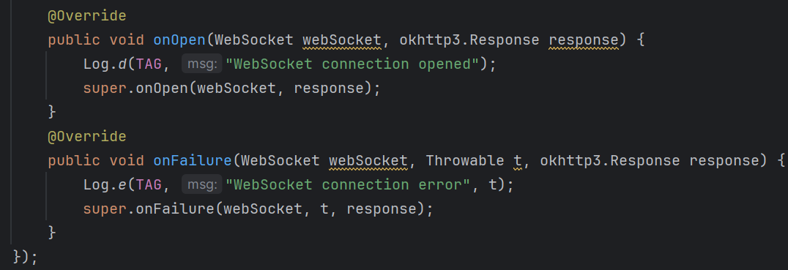
Establishing WebSocket Communication
1) Android App - Establishing the WebSocket Connection:

Slide 13
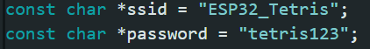
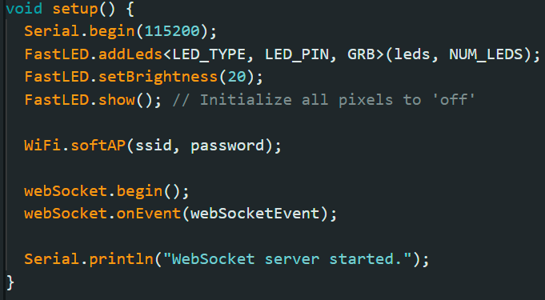
Establishing WebSocket Communication
2) ESP32 - Setting Up WebSocket:

Slide 14
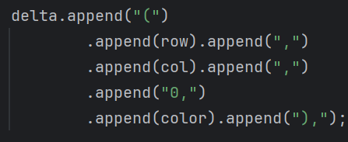
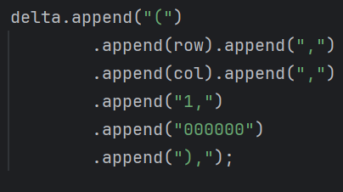
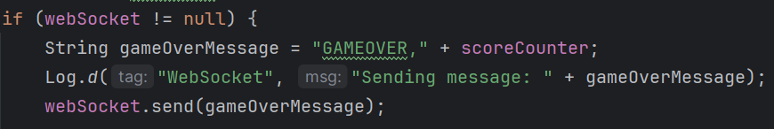
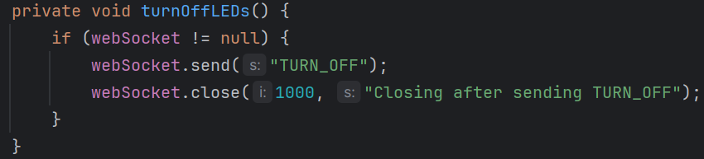
Data Types
There are 3 data types sent from the application:
(X, Y, 0/1, color)
“GAMEOVER,” + score
"TURN_OFF"

Slide 15
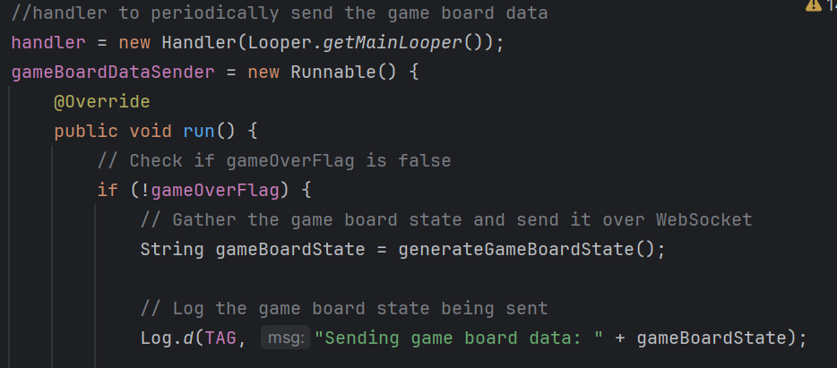
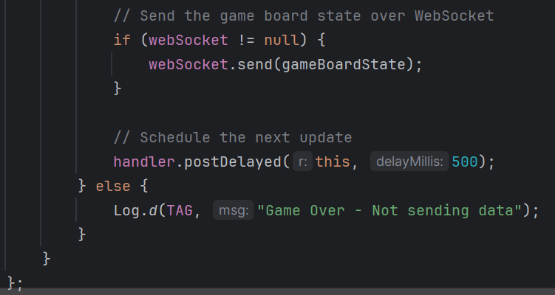
Sending The Data
Periodically Sending Game Board State Data:

Slide 16
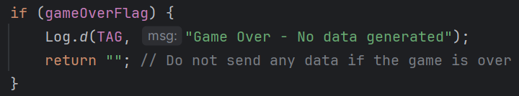
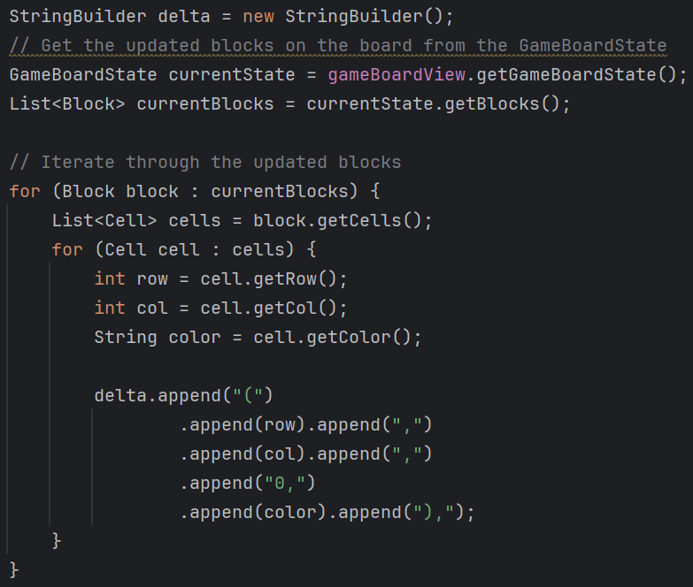
Generating The Game Board State
1) Handling Game Over State:
2) Generating the Current Game Board State:

Slide 17
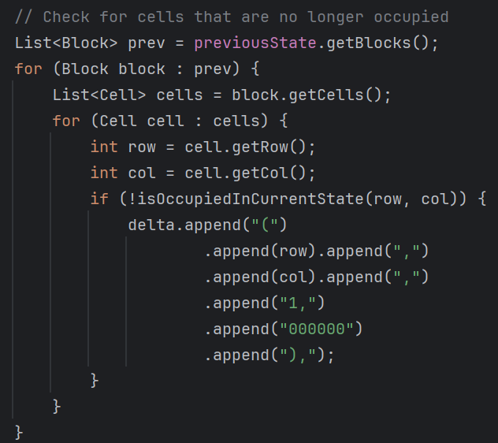
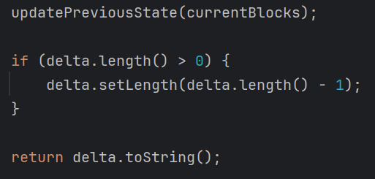
Generating The Game Board State
3) Checking for Cells No Longer Occupied:
4) Finalizing and Returning the String:

Slide 18
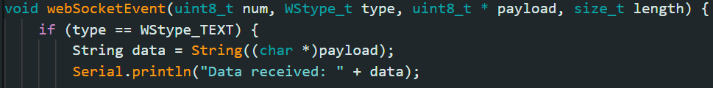
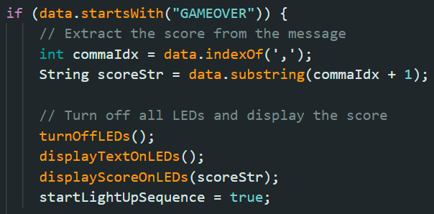
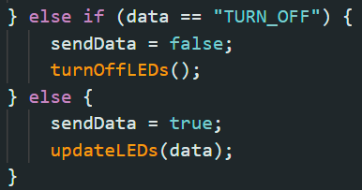
Receiving Data
ESP32: Handling WebSocket Events and Commands:

Slide 19
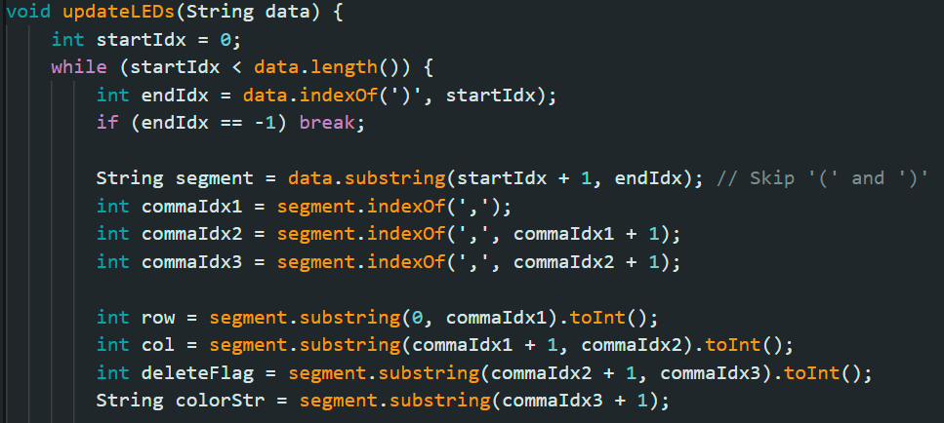
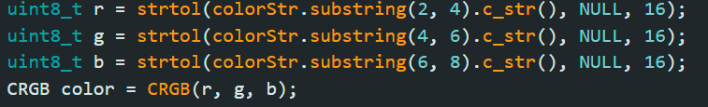
Translating The Data
Given data (X, Y, 0/1, color), how do we know what LEDs we should turn on/off:
1) split the giving string, save each coordinate in specific variable:
2) Handling the color:

Slide 20
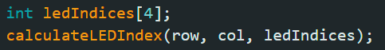
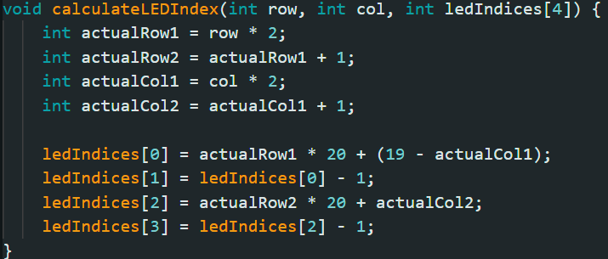
Translating The Data
3) calculating the LEDs indices we need to turn on/off:

Slide 21
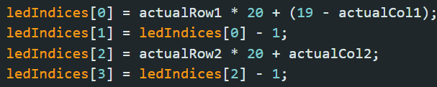
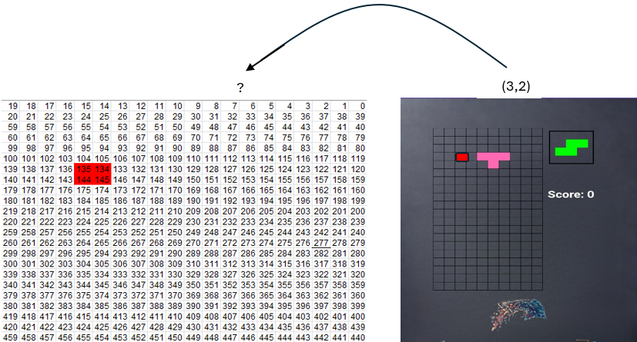
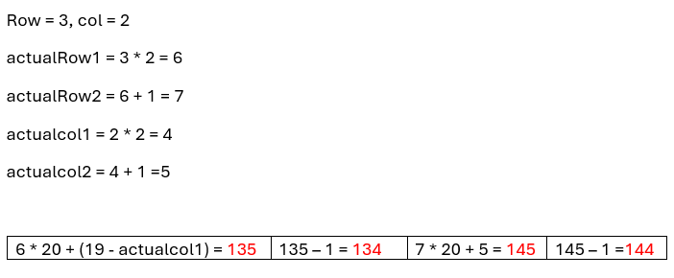
Translating The Data
3) Example:

Slide 22
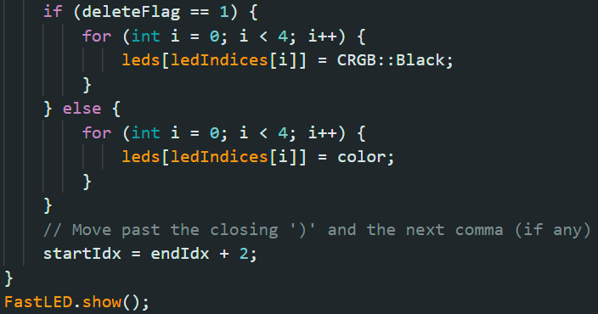
Translating The Data
4) update the LEDs accordingly:

Slide 23
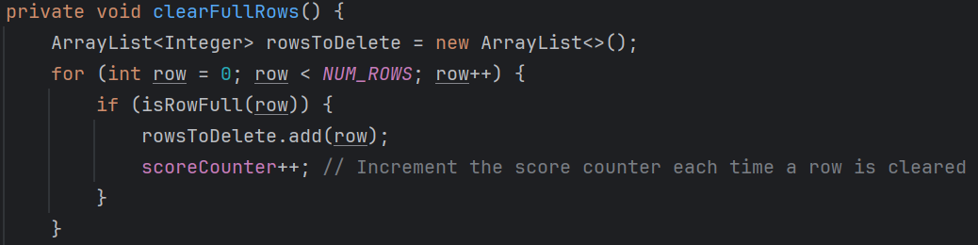
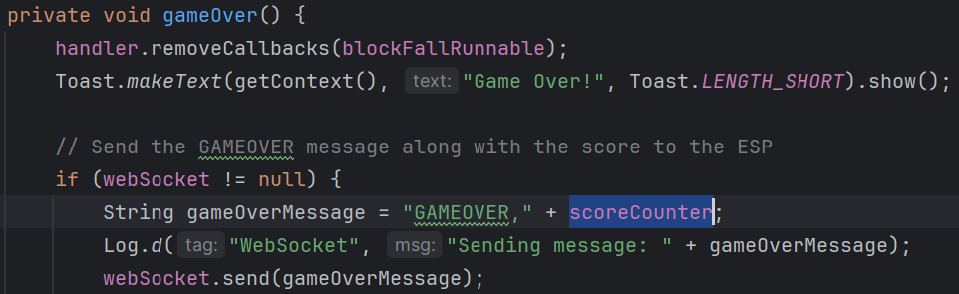
Handling The Score
1) On full row event increase the score counter by 1:
2) On game over event send through the web socket the gameover message with the current score counter:

Slide 24
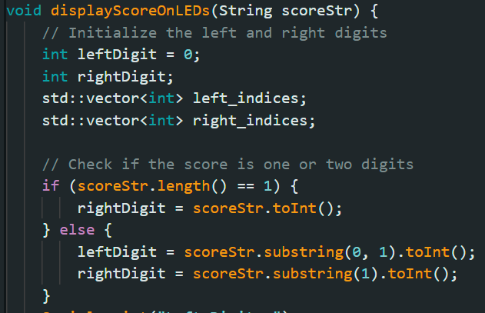
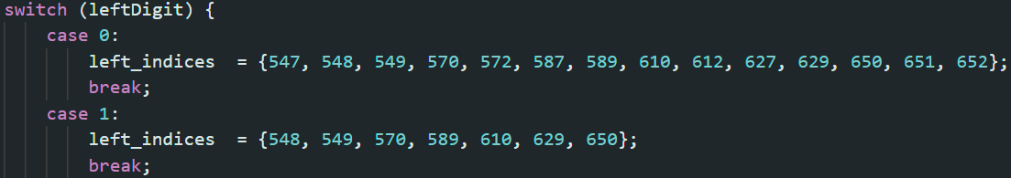
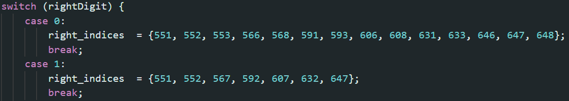
Handling The Score
3) Giving the score received form the app, treat it as 2-digits number:
4) Save the LED’s indices in the vectors depends on the specific digit value:

Slide 25
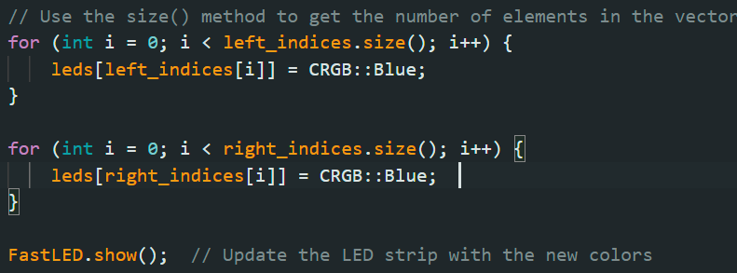
Handling The Score
5) Go over the two vectors and light up the corresponding LEDs:

Slide 26
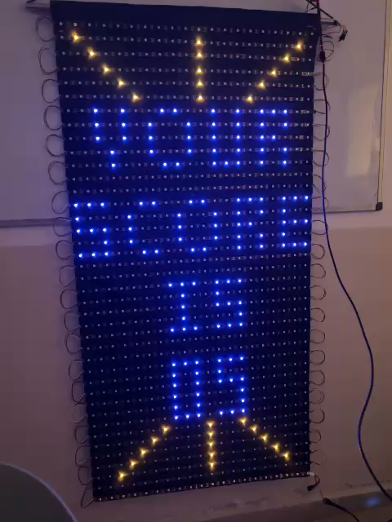
Handling The Score
The Final Result:

Slide 27
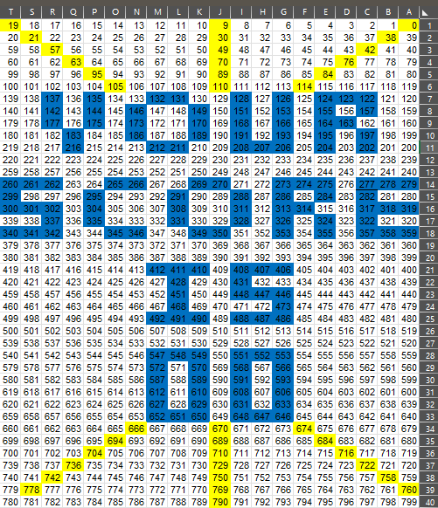
Detecting Specific LEDs
In order to easily detect the LEDs number for representing strings or numbers on the led matrix we used EXEL:

Slide 28
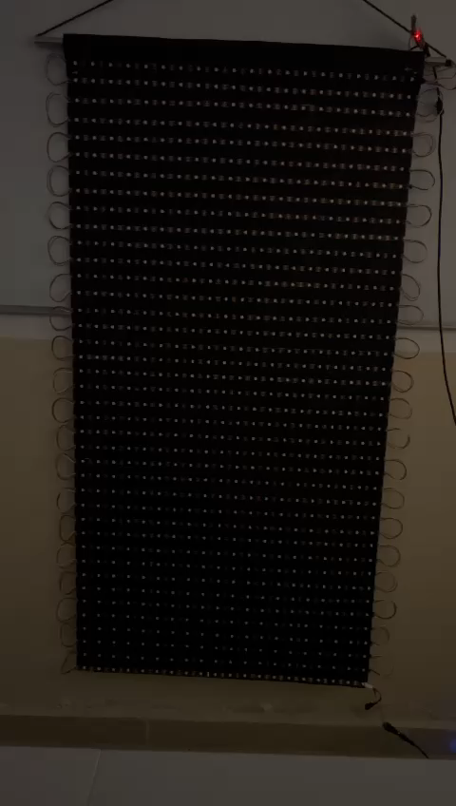
Challenges
We faced multiple challenges along the way:
Mechanical Part:
how to hang the LED matrix.
Hardware:
To find suitable power supply for our requirements.
Software:
To establish successful WebSocket connection.
To infer the colors correctly.
To handle the data received correctly and to know what is the best way to send it.
X,Y,COLOR – DELETE,X,Y

Slide 29
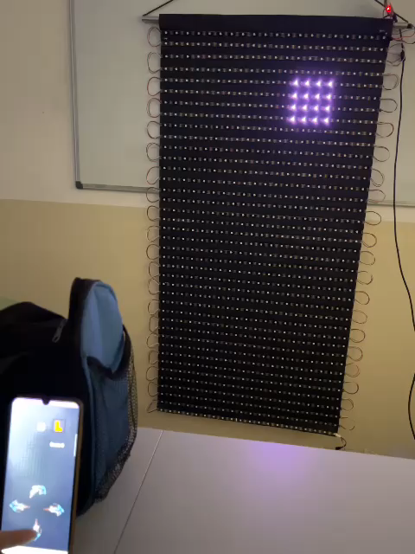
The Final Result

Slide 30


